Slide 1
LHC 10 m D2 Magnet 100 mm or 105 mm very preliminary cost and schedule estimates 29 June 2012 M. Anerella
US LHC Accelerator Research Program
bnl - fnal- lbnl - slac

Slide 2
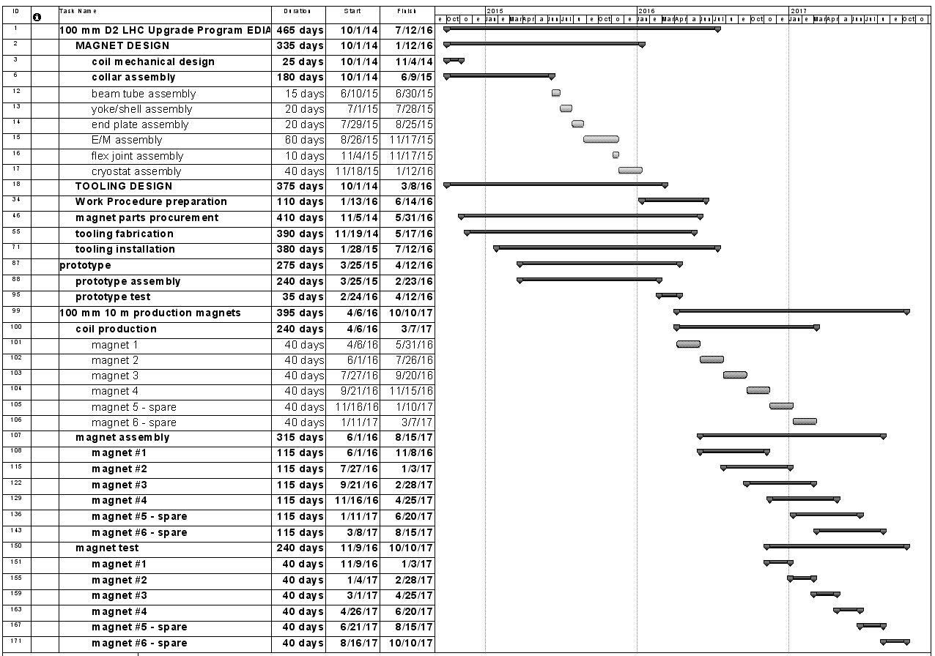
100 mm D2 schedule

Slide 3
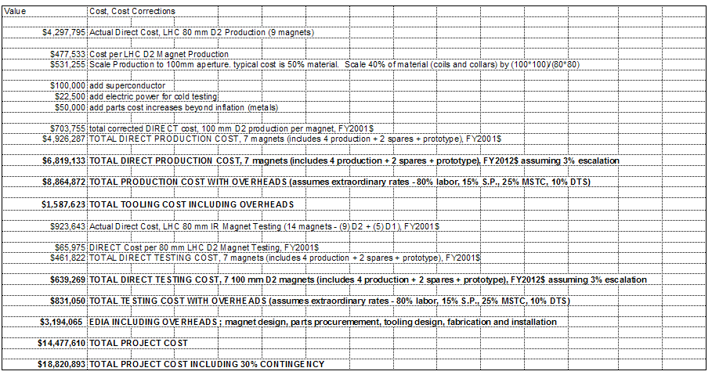
100 mm D2 Cost Summary

Slide 4
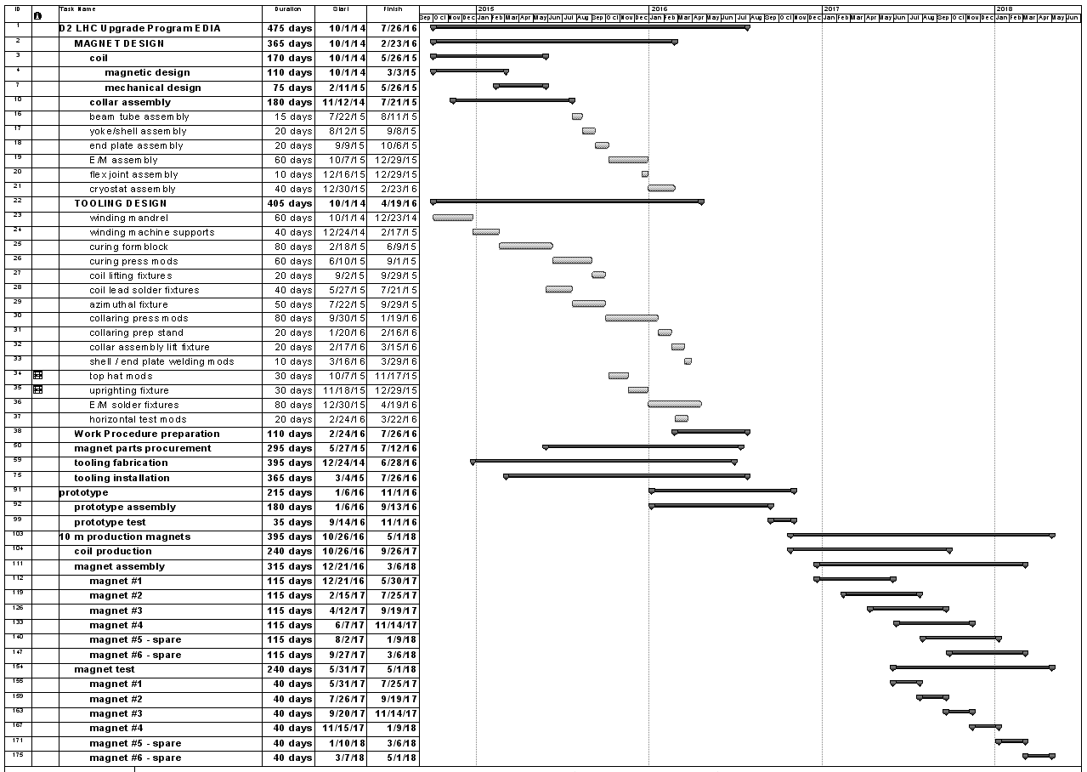
105 mm D2 schedule

Slide 5
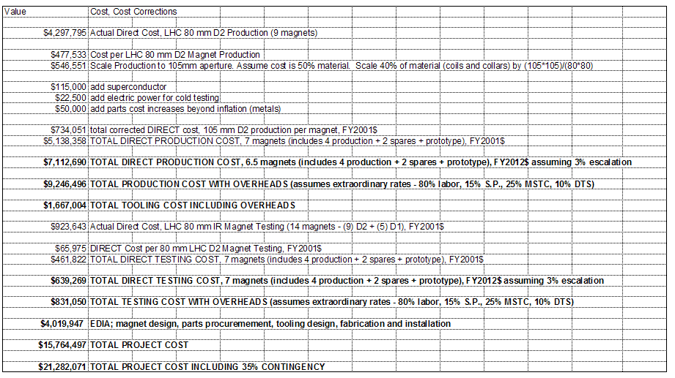
105 mm D2 Cost Summary

